Slide 1


Slide 2

Content:
March Email review
Email stats

Slide 3
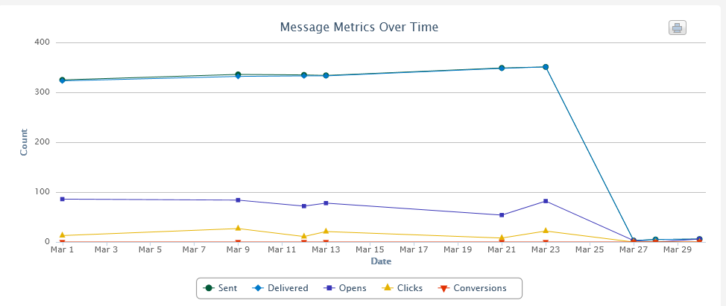
Message metrics - Inspin Newsletters
Click and open rate remain very steady. Will continue further subject
line testing and CTAs.

Slide 4
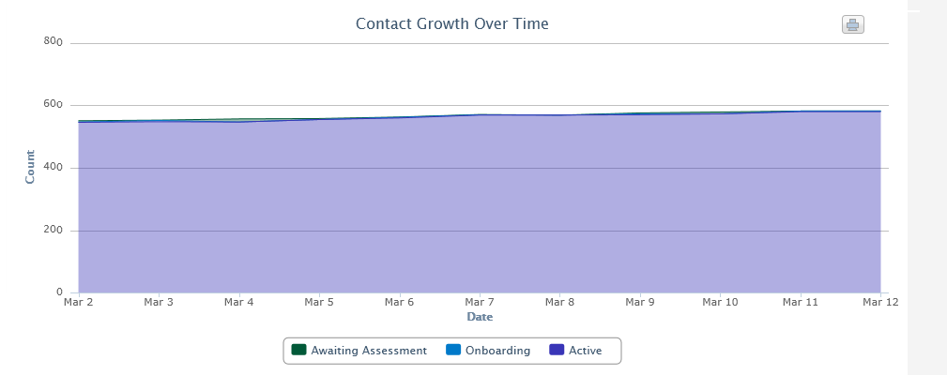
Contact growth - Inspin
Contact growth is now flat-lining. I think once we put our focus back on Inspin we will start seeing numbers rising north again.
These contacts are added to the DB when registering on Inspin and been directly added to Bronto.
All new contacts are double opt-in and will not be activated in Bronto until they validate their email address.

Slide 5
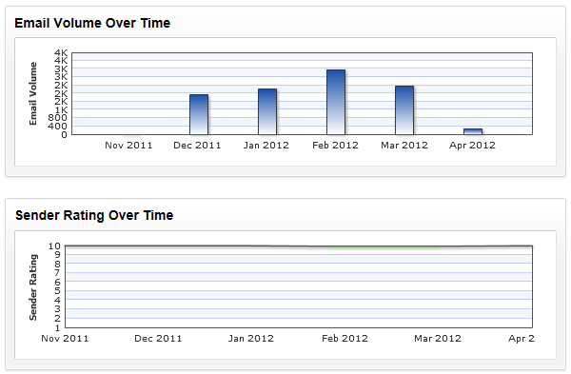
Deliverability and performance - Inspin
Email volume dropped in March due to SBO focus.
Our sender rating is excellent
Open rates on average are above industry standards.

Slide 6
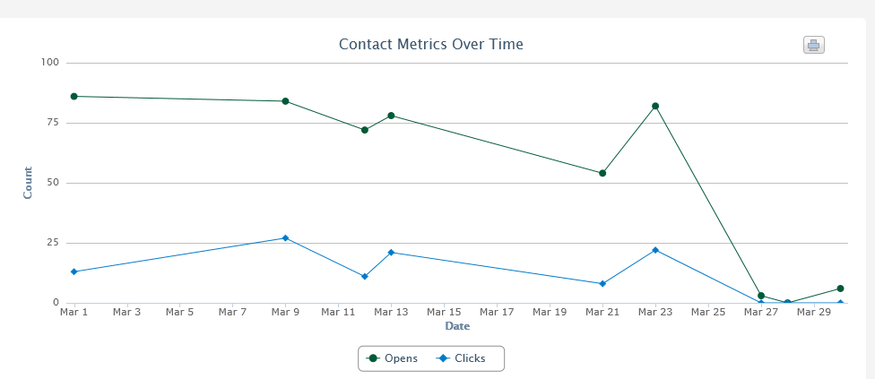
Contact metrics - Inspin Newsletters
Hyperlinks are out-performing video image. Need to make sure hyperlinks are added to all newsletters
We continue to see consistent results. I am trying to improve open & clicks rates by using a variety of subject lines, hyperlinks, images.

Slide 7
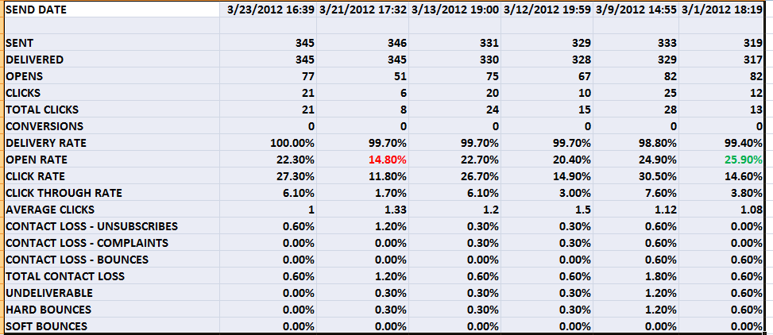
March newsletter stats - Inspin
We have a much better average open rate and are slightly over industry standards. Improvements can be made with targeted campaigns and continuing list hygiene exercises.

Slide 8

Automated mailers over time - Inspin
Welcome mailer:
6 day and 12 day conversion emails are averaging 37%-40% open rate, which is very good.
Open rates are excellent
Delivery rate is now much higher after I tightened up the opt-in process.

Slide 9
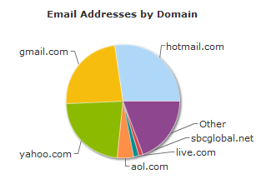
Top Domains - Inspin Newsletters
Yahoo, Hotmail & Gmail continue to be our principal domains.

Slide 10
Thank You
Scott Thompson
scott@vrbmarketing.com

